Slide 1
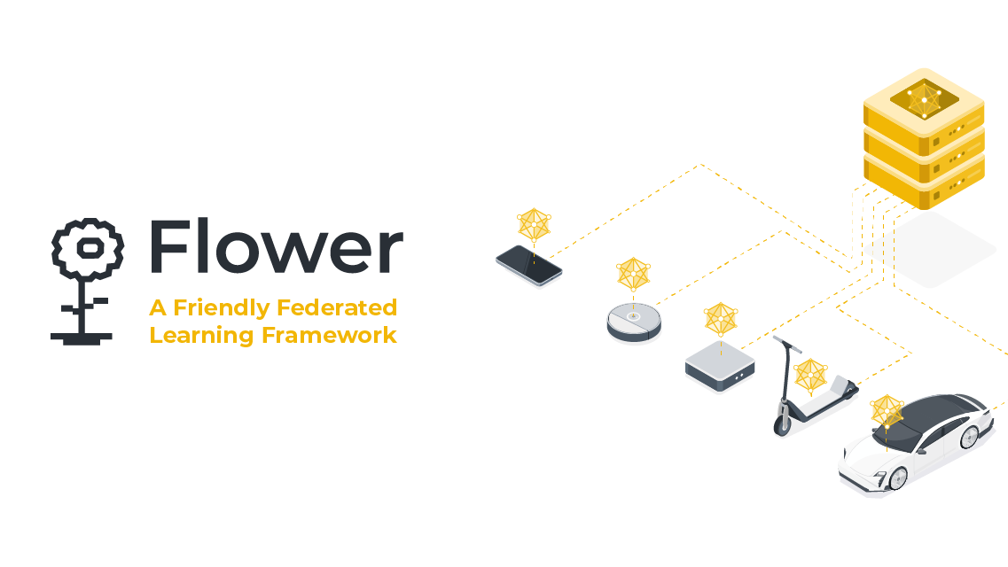
Flower Federated learning

Slide 2
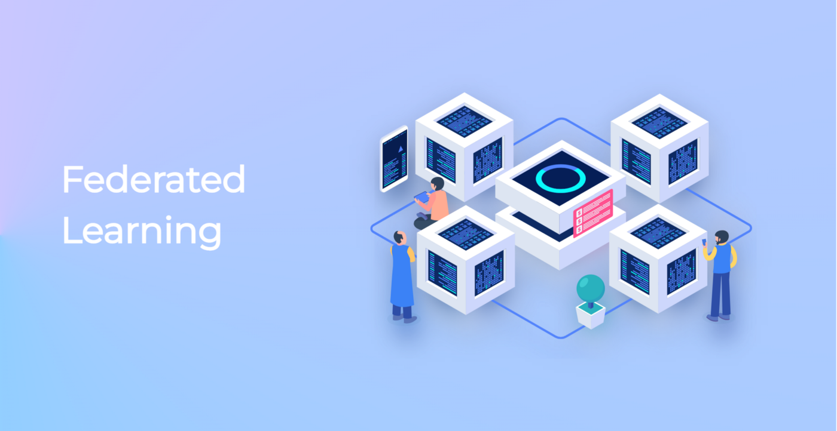
What is Federated Learning
Federated learning is a way to train AI models with decentralized approach without anyone seeing or touching your data, offering a way to unlock information to feed new AI applications.

Slide 3

Why decentral approach?

Slide 4
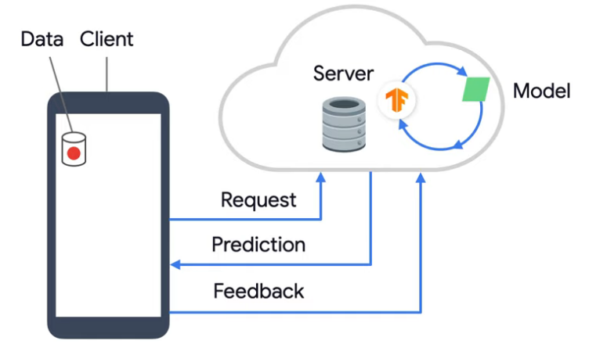
Centralized way of training models
-Collect all the data on server.
-Create a model on server.
-Clients talk to the server to make prediction.
-Back and forth communication with server hurts the user experience.

Slide 5
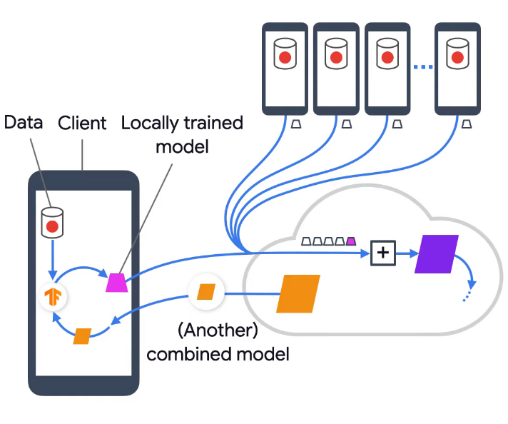
How Federated Learning works
-Each user has pre-trained model.
-User data never sent to central server.
-Model on server distributed to client
-Each client trains model locally with its local data and produces new model and sent it to server . The data to train model never leaves the device .

Slide 6
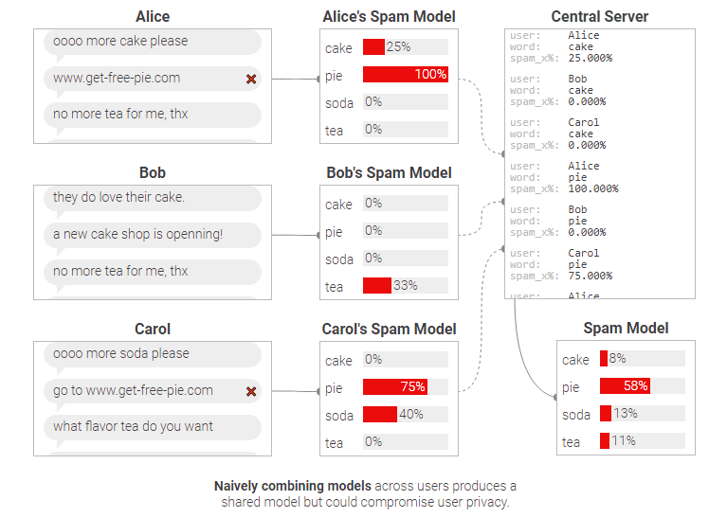
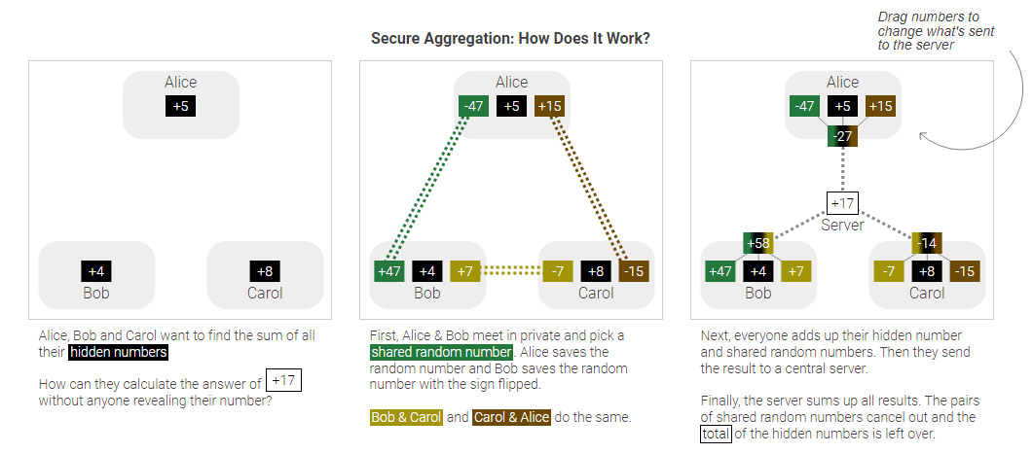
Secure aggregation
Server pairs devices with budy system.
Data from each device combine with random value before sending server.

Slide 7
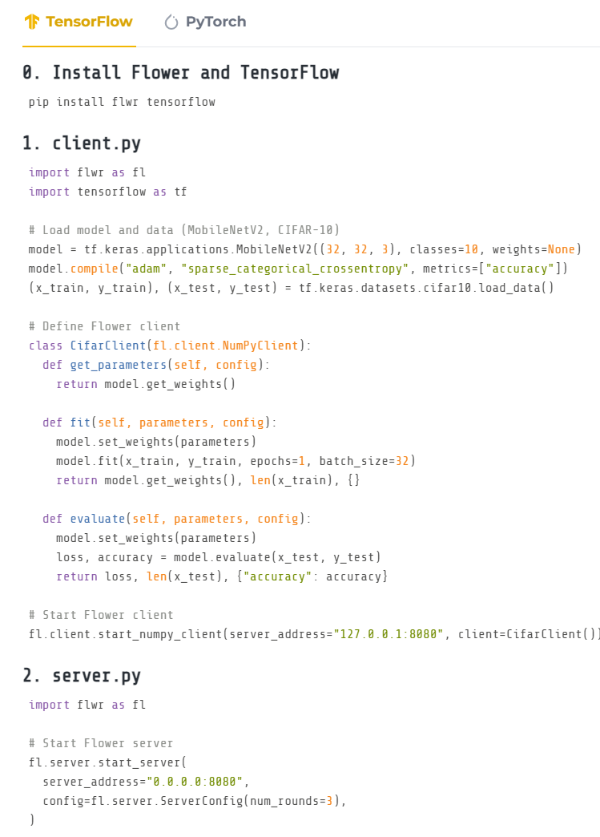
Flower Federated Learning

Slide 8
Referances
-A survey on security and privacy of federated learning(https://digitalcommons.kennesaw.edu/facpubs/5638/)
-Eluding Secure Aggregation in Federated Learning via Model Inconsistency( Dario Pasquini, Danilo Francati, Giuseppe Ateniese) : https://arxiv.org/abs/2111.07380
-https://pair.withgoogle.com/explorables/federated-learning/
-https://www.youtube.com/watch?v=X8YYWunttOY

